Slide 1
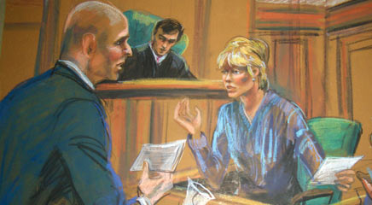

Eyewitness Testimony
[Instructor Name]
[Class and Section Number]
Notes:
This module of memory can be taught in a single class period or less. It can serve as a complementary application to the first module.
Technical Note: These slides may contain simple click animation so that you can focus students’ attention on a particular question, a selection of text, or an image and not have them be distracted by reading ahead. You can either preview the sequence of animation by going through the slides in slideshow view, visiting the animations tab, or reviewing the slide notes. In the notes you will see a cue - (Click) – that corresponds to each animation.
You will also find hyperlinks to outside videos at various places in the slides. These hyperlinks are embedded in text and indicated by color and in the notes section.

Slide 2
Overview
Testing Memory
What is Eyewitness Testimony?
Misinformation
Identifying Perpetrators
Kinds of Memory Biases
False Memory
Conclusion
Notes:
This slide provides an overview of the material that will be covered during the lecture.

Slide 3
Testing Memory
Remember
Hand
Inch
Boot
Smell
Mouth
Soccer
Toe
Sandals
Walk
Arm
Kick
Yard
Ankle
Sock
Shoe
Notes:
This slide provides the words students are asked to memorize during an activity that illustrates false memory.
Instructor’s note: See the final slide of the presentation for an alternative to this activity.
Activity: The Deese-Roediger-McDermot Effect (2 minutes – For full instructions, see IM > Memory > Module 2: Eyewitness Testimony and Memory Bias > Activities/Demonstrations)
Display the word list on this slide for students to memorize.
Give them some time to remember the word list, but do not have them write anything down.
Once they have had enough time, begin lecture as normal. You will return to this at the end of this slideshow, asking students to remember the words, to see how well students were able to remember and discuss the results.

Slide 4
Overview
Testing Memory
What is Eyewitness Testimony?
Misinformation
Identifying Perpetrators
Kinds of Memory Biases
False Memory
Conclusion
Notes:
This slide provides an overview of the material that will be covered during the lecture.

Slide 5
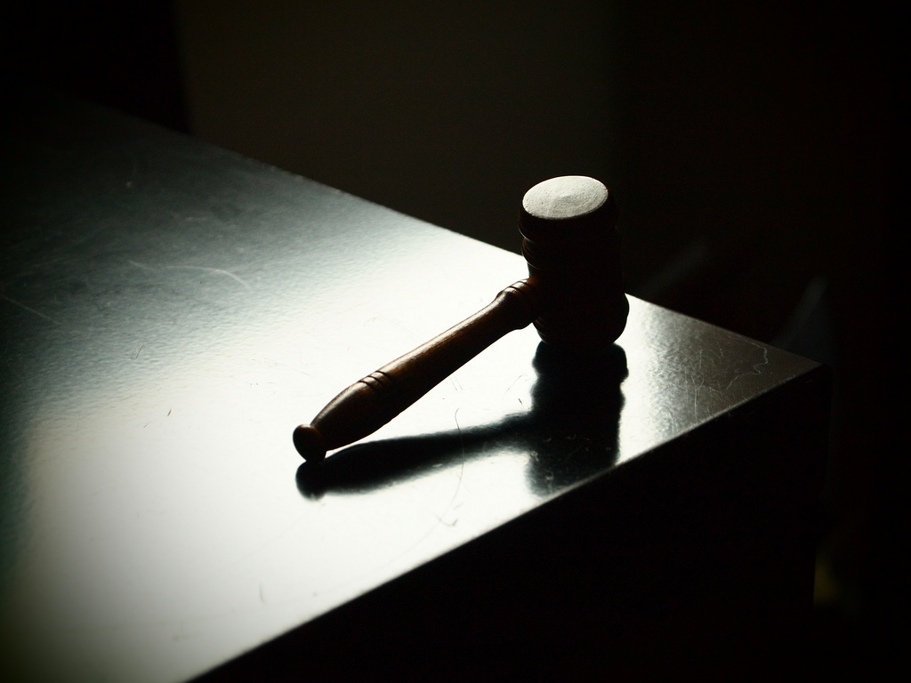
What is Eyewitness Testimony?
Notes:
This slide provides an introduction to what eyewitness testimony is and its influence on court cases.
When an eyewitness stands up in front of the court and describes what happened from her own perspective, this testimony can be extremely compelling—it is hard for those hearing this testimony to take it “with a grain of salt,” or otherwise adjust its power. But to what extent is this necessary?
Discussion/Activity: To introduce the concept of eyewitness testimony, it may be helpful to provide students with two scenarios:
Scenario 1 – The students are to imagine themselves on the jury of a court case involving an African American man who has been accused of breaking into an apartment on two separate occasions, severing phone wires, sexually assaulting a woman, and searching through her belongings, taking money and other items. The man claims to be innocent and offers an alibi for both nights, which is supported by his family members. Additionally, no witnesses were present at the scene except the victim who was not able to identify her assailant. The only prosecuting evidence available is that a flashlight in the man’s home resembled the one used by the assailant and rubber from the man’s tennis shoe was consistent with rubber found at one of the crime scenes. Given this evidence, would you convict him of rape?
Scenario 2 – Again, the students are to imagine themselves on the same jury hearing the same case. An African American man has been accused of breaking into an apartment on two separate occasions, severing phone wires, sexually assaulting a woman, and searching through her belongings, taking money and other items. The man claims to be innocent and offers an alibi for both nights, which is supported by his family members. The only prosecuting evidence available is that a flashlight in the man’s home resembled the one used by the assailant and rubber from the man’s tennis shoe was consistent with rubber found at one of the crime scenes. Given this evidence, would you convict him of rape? However, this time the victim has selected the accused man out of a police lineup and has testified twice in court that he is the individual who assaulted her. She reports being 100% confident in her selection, as she could not forget the face of the man who assaulted her. Would you convict this man of rape?
Ask for a show of hands to determine how many students in each scenario would provide a guilty vote. Inevitably, significantly more students will be inclined to provide a guilty vote in scenario B. The instructor may wish to ask students what led them to provide a guilty vote in scenario B. The goal is to get students talking about the persuasive influence of eyewitness testimony. Students are encouraged to relate the value of eyewitness testimony to other cases (e.g., someone claiming they saw a specific individual steal money). The instructor should then provide information regarding the case of Ronald Cotton, the content of which is identical to the aforementioned scenario B. This information can be found in the notes of the next slide.

Slide 6
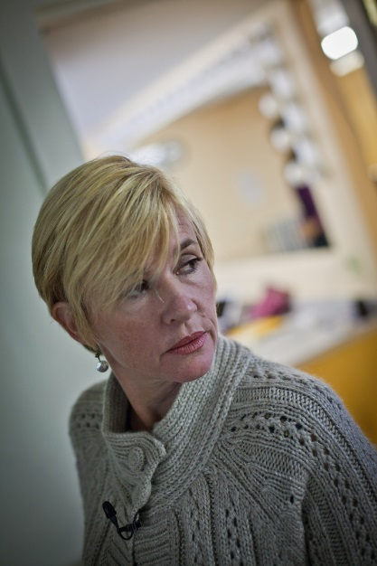
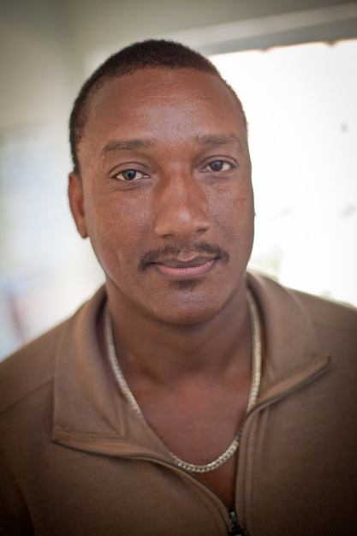
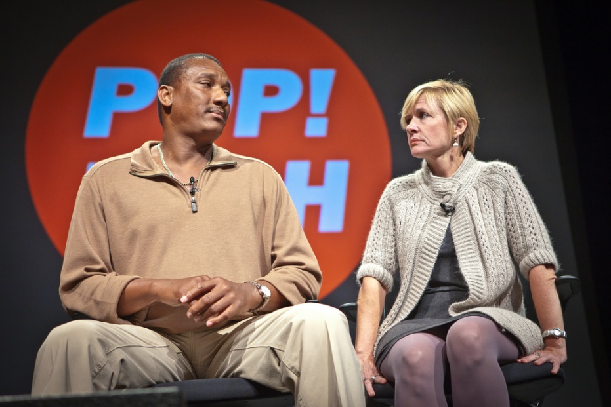
What is Eyewitness Testimony?
Notes:
This slide introduces the case of Ronald Cotton as an example of when eyewitness testimony is wrong.
Explanation: In 1984, Ronald Cotton was identified by a rape victim, Jennifer Thompson, as her rapist, and, despite a supported alibi and minimal prosecuting evidence (beyond the eyewitness testimony of Jennifer Thompson), was found guilty and sentenced to life in prison. After more than 10 years, he was exonerated (and the real rapist identified) based on DNA evidence. For details on this case and other (relatively) lucky individuals whose false convictions were subsequently overturned with DNA evidence, see the Innocence Project website (http://www.innocenceproject.org/).
There is now a wealth of evidence, from research conducted over several decades, suggesting that eyewitness testimony is probably the most persuasive form of evidence presented in court (as evidenced by the exercise in slide 5), but in many cases, its accuracy is dubious. There is also evidence that mistaken eyewitness evidence can lead to wrongful conviction—sending people to prison for years or decades, even to death row, for crimes they did not commit. Faulty eyewitness testimony has been implicated in least 75% of DNA exoneration cases—more than any other cause (Garrett, 2011).
Note: In the time since his conviction was overturned Ronald Cotton has forgiven Jennifer Thompson and the two have become close friends. They have done many interviews together about the ordeal both experienced and have co-authored a book.
Discussion: What factors might have contributed to the error in judgment for the Ronald Cotton/Jennifer Thompson case?
Answers: Students might talk about racial discrimination/stereotyping and the emotional trauma involved in rape causing a inability to remember accurately, for example.
There is also hope, though, that many of the errors may be avoidable if proper precautions are taken during the investigative and judicial processes. Psychological science has taught us what some of those precautions might involve, and we’ll discuss some of that science now.

Slide 7
Overview
Testing Memory
What is Eyewitness Testimony?
Misinformation
Identifying Perpetrators
Kinds of Memory Biases
False Memory
Conclusion
Notes:
This slide provides an overview of the material that will be covered during the lecture.

Slide 8
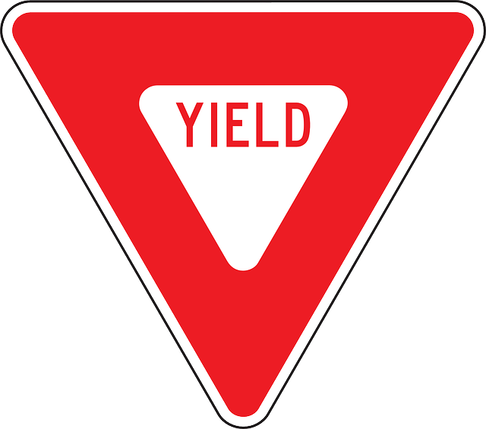

Misinformation
Misinformation effect – Occurs when incorrect information obtained after an event contaminates our memory of that event.
Notes:
This slide introduces students to the misinformation effect.
Lecture info: In an early study of eyewitness memory, undergraduate subjects first watched a slideshow depicting a small red car driving and then hitting a pedestrian (Loftus, Miller, & Burns, 1978). Some subjects were then asked leading questions about what had happened in the slides. For example, subjects were asked, “How fast was the car traveling when it passed the yield sign?” But this question was actually designed to be misleading, because the slide included a stop sign rather than a yield sign.
Later, subjects were shown pairs of slides. One of the pair was the original slide containing the stop sign; the other was a replacement slide containing a yield sign. Subjects were asked which of the pair they had previously seen. Subjects who had been asked about the yield sign were likely to pick the slide showing the yield sign, even though they had originally seen the slide with the stop sign. In other words, the misinformation in the leading question led to inaccurate memory.
This phenomenon is called the misinformation effect, because the misinformation that subjects were exposed to after the event (here in the form of a misleading question) apparently contaminates subjects’ memories of what they witnessed. Hundreds of subsequent studies have demonstrated that memory can be contaminated by erroneous information that people are exposed to after they witness an event (see Frenda, Nichols, & Loftus, 2011; Loftus, 2005). The misinformation in these studies has led people to incorrectly remember everything from small but crucial details of a perpetrator’s appearance to objects as large as a barn that wasn’t there at all.
Note: Two short (3-minutes) student-made videos about the Misinformation Effect can be found here - http://nobaproject.com/student-video-award/winners
Both were finalists in the 2014 Noba Student Video Award.

Slide 9

Misinformation
Notes:
This slide clearly articulates the way in which discussion with neutral individuals (e.g., co-witnesses) can still lead to the misinformation effect because some students make the assumption that the misinformation effect occurs when an individual who wishes to manipulate your memory (e.g., an experimenter or a lawyer) does so intentionally.
Discussion question: Do you think it’s possible for misinformation to happen accidentally, or do you think it most often happens intentionally? Do you think it’s likely for two people who witness the same crime or accident to remember those events very differently?
Explanation: Studies have shown that misinformation can corrupt memory even more easily when it is encountered in social situations (Gabbert, Memon, Allan, & Wright, 2004). This is a problem particularly in cases where more than one person witnesses a crime. In these cases, witnesses tend to talk to one another in the immediate aftermath of the crime, including as they wait for police to arrive. But because different witnesses are different people with different perspectives, they are likely to see or notice different things, and thus remember different things, even when they witness the same event. So when they communicate about the crime later, they not only reinforce common memories for the event, they also contaminate each other’s memories for the event (Gabbert, Memon, & Allan, 2003; Paterson & Kemp, 2006; Takarangi, Parker, & Garry, 2006).
Laboratory example: The misinformation effect has been modeled in the laboratory. Researchers had subjects watch a video in pairs. Both subjects sat in front of the same screen, but because they wore differently polarized glasses, they saw two different versions of a video, projected onto a screen. So, although they were both watching the same screen, and believed (quite reasonably) that they were watching the same video, they were actually watching two different versions of the video (Garry, French, Kinzett, & Mori, 2008).
In the video, Eric the electrician is seen wandering through an unoccupied house and helping himself to the contents thereof. A total of eight details were different between the two videos. After watching the videos, the “co-witnesses” worked together on 12 memory test questions. Four of these questions dealt with details that were different in the two versions of the video, so subjects had the chance to influence one another. Then subjects worked individually on 20 additional memory test questions. Eight of these were for details that were different in the two videos. Subjects’ accuracy was highly dependent on whether they had discussed the details previously. Their accuracy for items they had not previously discussed with their co-witness was 79%. But for items that they had discussed, their accuracy dropped markedly, to 34%. That is, subjects allowed their co-witnesses to corrupt their memories for what they had seen.

Slide 10
Overview
Testing Memory
What is Eyewitness Testimony?
Misinformation
Identifying Perpetrators
Kinds of Memory Biases
False Memory
Conclusion
Notes:
This slide provides an overview of the material that will be covered during the lecture.

Slide 11
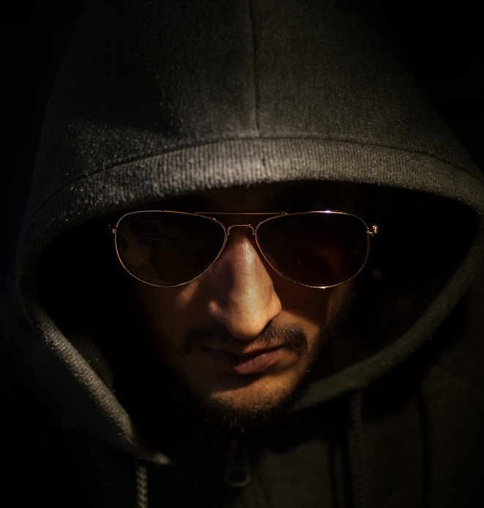
Identifying Perpetrators
Factors Increasing Errors
Poor Vision
Poor Viewing Conditions
Stress
Short Viewing Time
Delay
Different Race
Notes:
This slide focuses on how lineups are conducted and the factors that increase the likelihood of eyewitness error.
In addition to correctly remembering many details of the crimes they witness, eyewitnesses often need to remember the faces and other identifying features of the perpetrators of those crimes. Eyewitnesses are often asked to describe that perpetrator to law enforcement and later to make identifications from books of mug shots or lineups. Here, too, there is a substantial body of research demonstrating that eyewitnesses can make serious, but often understandable and even predictable, errors (Caputo & Dunning, 2007; Cutler & Penrod, 1995).
Discussion questions: What do you think the most effective procedure for a lineup would be? Should factors like the mood and race of the eyewitness be taken into account? (Answers will vary.)
Explanation: In most jurisdictions in the United States, lineups are typically conducted with pictures, called photo spreads, rather than with actual people standing behind one-way glass (Wells, Memon, & Penrod, 2006). The eyewitness is given a set of small pictures of perhaps six or eight individuals who are dressed similarly and photographed in similar circumstances. One of these individuals is the police suspect, and the remainder are “foils” or “fillers” (people known to be innocent of the particular crime under investigation). If the eyewitness identifies the suspect, then the investigation of that suspect is likely to progress. If a witness identifies a foil or no one, then the police may choose to move their investigation in another direction.
This process is modeled in laboratory studies of eyewitness identifications. In these studies, research subjects witness a mock crime (often as a short video) and then are asked to make an identification from a photo or a live lineup. Sometimes the lineups are target present, meaning that the perpetrator from the mock crime is actually in the lineup, and sometimes they are target absent, meaning that the lineup is made up entirely of foils. The subjects, or mock witnesses, are given some instructions and asked to pick the perpetrator out of the lineup. The particular details of the witnessing experience, the instructions, and the lineup members can all influence the extent to which the mock witness is likely to pick the perpetrator out of the lineup, or indeed to make any selection at all. Mock witnesses (and indeed real witnesses) can make errors in two different ways. They can fail to pick the perpetrator out of a target present lineup (by picking a foil or by neglecting to make a selection), or they can pick a foil in a target absent lineup (wherein the only correct choice is to not make a selection).
Discussion question: What factors do you think contribute most to eyewitness error? (Answers will vary.)
Answers: Some factors have been shown to make eyewitness identification errors particularly likely.
(Click) Poor vision
(Click) Poor viewing conditions
These include poor vision or viewing conditions during the crime…
(Click) Stress
particularly stressful witnessing experiences…
(Click) Short viewing time
too little time to view the perpetrator or perpetrators…
(Click) Delay
too much delay between witnessing and identifying
(Click) Different race
and being asked to identify a perpetrator from a race other than one’s own (Bornstein, Deffenbacher, Penrod, & McGorty, 2012; Brigham, Bennet, Meissner, & Mitchell, 2007; Burton, Wilson, Cowan, & Bruce, 1999; Deffenbacher, Bornstein, Penrod, & McGorty, 2004).

Slide 12
Overview
Testing Memory
What is Eyewitness Testimony?
Misinformation
Identifying Perpetrators
Kinds of Memory Biases
False Memory
Conclusion
Notes:
This slide provides an overview of the material that will be covered during the lecture.

Slide 13
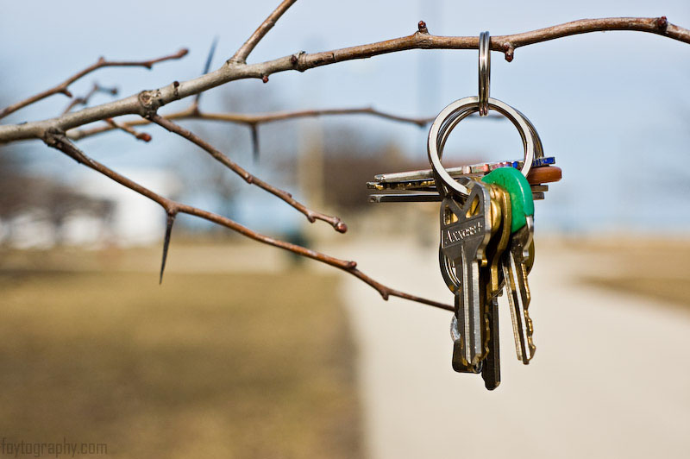

Kinds of Memory Biases
Tip-of-the-Tongue Effect
Schemata
Notes:
This slide introduces two types of memory bias: tip-of-the-tongue effect and schemata.
Lecture info: Memory is also susceptible to a wide variety of other biases and errors. People can forget events that happened to them and people they once knew. They can mix up details across time and place. They can even remember whole complex events that never happened at all. Importantly, these errors, once made, can be very hard to unmake. A memory is no less “memorable” just because it is wrong.
Discussion question: What are some instances of memory errors that you, and most people, have experienced? (Answers will vary, but students may talk about misplacing something, forgetting someone’s name, etc.)
(Click) Tip-of-the-tongue Effect
Explanation: Some types of memory errors are considered to be simple and short-lived memory biases:
Some small memory errors are commonplace, and you have no doubt experienced many of them. You set down your keys without paying attention, and then cannot find them later when you go to look for them. You try to come up with a person’s name but cannot find it, even though you have the sense that it is right at the tip of your tongue (psychologists actually call this the tip-of-the-tongue effect, or TOT) (Brown, 1991).
(Click) Schemata
Explanation: Other types of memory errors are considered complex and long-lasting memory biases:
For example, it turns out that our expectations and beliefs about how the world works can have huge influences on our memories. Because many aspects of our everyday lives are full of redundancies, our memory systems take advantage of the recurring patterns by forming and using schemata, or memory templates (Alba & Hasher, 1983; Brewer & Treyens, 1981). Thus, we know to expect that a library will have shelves and tables and librarians, and so we don’t have to spend energy noticing these at the time. The result of this lack of attention, however, is that one is likely to remember schema-consistent information (such as tables), and to remember them in a rather generic way, whether or not they were actually present.
Discussion: Ask students if they’ve ever experienced these schematic memory biases.

Slide 14
Overview
Testing Memory
What is Eyewitness Testimony?
Misinformation
Identifying Perpetrators
Kinds of Memory Biases
False Memory
Conclusion
Notes:
This slide provides an overview of the material that will be covered during the lecture.

Slide 15
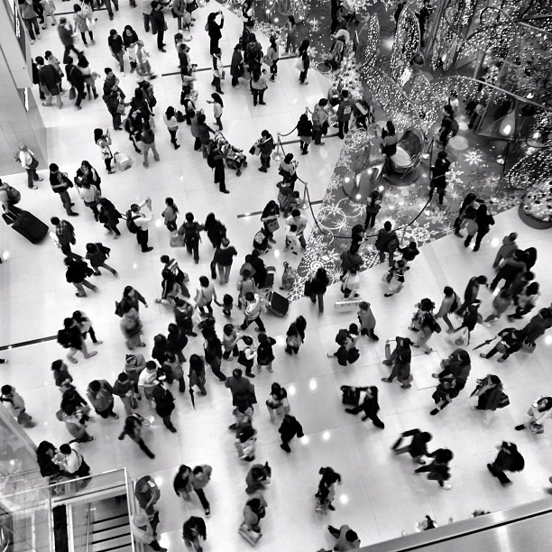
False Memory
False Memories – Large memory errors in which events are recalled that never took place.
Notes:
This slide introduces false memories, another type of memory bias.
Instructor note: You might have some students who did experience abuse or witness something particularly stressful, and if you are not careful with describing false memories, they may feel like you are invalidating their experience/memory.
Discussion question: If you wanted to convince someone that they remember something that never happened, how might you go about convincing them of this, or do you think this would be impossible?
Explanation: One large, serious type of memory bias is false memories, memories for an event that ever happened, implanted by someone else.
Research example: In early false memory studies, undergraduate subjects’ family members were recruited to provide events from the students’ lives. The student subjects were told that the researchers had talked to their family members and learned about four different events from their childhoods. The researchers asked if the now undergraduate students remembered each of these four events—introduced via short hints. The subjects were asked to write about each of the four events in a booklet and then were interviewed two separate times. The trick was that one of the events came from the researchers rather than the family (and the family had actually assured the researchers that this event had not happened to the subject). In the first such study, this researcher-introduced event was a story about being lost in a shopping mall and rescued by an older adult. In this study, after just being asked whether they remembered these events occurring on three separate occasions, a quarter of subjects came to believe that they had indeed been lost in the mall (Loftus & Pickrell, 1995). In subsequent studies, similar procedures were used to get subjects to believe that they nearly drowned and had been rescued by a lifeguard, or that they had spilled punch on the bride’s parents at a family wedding, or that they had been attacked by a vicious animal as a child, among other events (Heaps & Nash, 1999; Hyman, Husband, & Billings, 1995; Porter, Yille, & Lehman, 1999).
Importantly, once these false memories are implanted—whether through complex methods or simple ones—it is extremely difficult to tell them apart from true memories (Berstein & Loftus, 2009a; Laney & Loftus, 2008).
Discussion question: What are the ethical implications of implanting people with false memories?
Answer: Students might share that this is unethical and manipulative.
Follow-up to Deese-Roediger-McDermot Effect Activity (from slide 3):
Have students recall as many words as possible (have them write them down).
After all students have written down every word they can remember, show the original list on slide 3 to students and have them check their own work, crossing out any words that were not on the original list.
Then ask who wrote down the key word that was not on the original list (in this example, the key word is “foot”).
You will see that several students raise their hand.
Discussion: How does this relate to misinformation and false memories. Why do you think some students remembered the same wrong word?
This tends to be a very effective activity for showing students how vulnerable our memories are to contextual cues and outside information.

Slide 16
Overview
Testing Memory
What is Eyewitness Testimony?
Misinformation
Identifying Perpetrators
False Memory
Conclusion
Notes:
This slide provides an overview of the material that will be covered during the lecture.

Slide 17



Conclusion
Witness Interviews
Lineup Construction
Educating Jury Members
Educating Other Assessors
Notes:
This slide identifies ways in which the research and insight related to eyewitness testimony might be used to ensure that justice is served within our judicial system.
To conclude, eyewitness testimony is very powerful and convincing to jurors, even though it is not particularly reliable. Identification errors occur, and these errors can lead to people being falsely accused and even convicted. Likewise, eyewitness memory can be corrupted by leading questions, misinterpretations of events, conversations with co-witnesses, and their own expectations for what should have happened. People can even come to remember whole events that never occurred.
Discussion question: The problems with memory in the legal system are real. But what do you think we can do to start to fix them?
Explanation: A number of specific recommendations have already been made, and many of these are in the process of being implemented (e.g., Stebley & Loftus, 2012; Technical Working Group for Eyewitness Evidence, 1999; Wells et al., 1998). Some of these recommendations are aimed at specific legal procedures, including
(Click) Witness Interviews
when and how witnesses should be interviewed,
(Click) Lineup Construction
and how lineups should be constructed and conducted.
(Click) Educating Jury Members
(Click) Educating Other Assessors
Other recommendations call for appropriate education (often in the form of expert witness testimony) to be provided to jury members and others tasked with assessing eyewitness memory. Eyewitness testimony can be of great value to the legal system, but decades of research now argue that this testimony is often given far more weight than its accuracy justifies.

Slide 18
Appendix A: Optional Activity
Notes:
This slide provides information (in the notes) regarding an optional activity that can be conducted at the beginning of class. This information can also be found in the Eyewitness Testimony > Activities/Demonstrations section of the IM.
Activity: This activity should be done during class and occurs in two parts. In the first part of this activity, students are shown a clip from a movie or TV show. Class is then taught as normal (it’s best if you can teach something unrelated to eyewitness as it might give it away). Toward the end of class, you then give students a quiz on what they saw.
Time: 10-15 minutes (5 minutes for video, 5-10 for quiz and discussion)
Materials: Video, memory quiz (either via handout or overhead).
Directions:
If you want to do this, you have to make sure to plan ahead of time – you will need to expose students to the video well before you ask them questions about the details of the video. For this activity, you will pick out a video that is appropriate for class (you might consider picking a clip where a small crime is committed so you can later ask about the perpetrator). Remember that you don’t want to give away the point of watching the video, so you may want to come up with some pre-text for watching the clip (e.g., Gee & Dyk, 1998, play a video of a robbery and tell students they are watching the video to “wake them up” before class).
Once students have watched the video, begin lecture as normal. Towards the end of lecture, give students the eye-witness recall quiz, where they identify details about the video (e.g., what clothes the person was wearing, things they said or did, etc.).
If you create your own quiz consider making a target absent line-up (the target is not actually present; see the module for additional suggestions for creating a line-up).
Also consider altering the wording for half the class (e.g., How old was the man in the red shirt vs. How old was the boy in the red shirt).
After they answer all questions, go through the correct list of answers. You will see that several students were not able to accurately recall details of the video clip. This tends to be a very effective activity for showing students how difficult it can be to remember important details after some time has passed.
If you don’t want to find your own video or create your own worksheet, there are some available from ToPIX (they may require flash or internet access):
http://www.psychology.iastate.edu/~glwells/theeyewitnesstest.html (suspect absent line-up)
http://www.youramazingbrain.org.uk/testyourself/eyewitness.htm

Slide 19
Photo Attribution
Slide 1 | Photo Credit: Marilyn Church http://www.loc.gov/loc/lcib/11012/detail/courtroom02.html http://en.wikipedia.org/wiki/en:public_domain
Slide 5 | Photo Credit: orangesparrow https://www.flickr.com/photos/38409127@N08/5621813850/ https://creativecommons.org/licenses/by-nc-nd/2.0/
Slide 6 | Photo Credit: poptech https://www.flickr.com/photos/40287103@N07/5105594032 https://creativecommons.org/licenses/by-sa/2.0/
Slide 6 | Photo Credit: poptech https://www.flickr.com/photos/40287103@N07/5104992149/ https://creativecommons.org/licenses/by-sa/2.0/
Slide 6 | Photo Credit: poptech https://www.flickr.com/photos/40287103@N07/5104979349/ https://creativecommons.org/licenses/by-sa/2.0/
Slide 8 | Photo Credit: https://openclipart.org/detail/19620/yield-road-sign-by-schoolfreeware-19620 http://creativecommons.org/publicdomain/zero/1.0/
Slide 8 | Photo Credit: https://openclipart.org/detail/167093/stop-sign-by-davidblyons http://creativecommons.org/publicdomain/zero/1.0/
Slide 9 | Photo Credit: Selena Wilke http://upload.wikimedia.org/wikipedia/commons/f/ff/Two-people-talking-logo.jpg http://en.wikipedia.org/wiki/en:public_domain
Slide 11 | Photo Credit: timsnell https://www.flickr.com/photos/43822137@N00/11116016075/ https://creativecommons.org/licenses/by-nd/2.0/
Slide 13 | Photo Credit: peyri https://www.flickr.com/photos/54552940@N00/1838873866/ https://creativecommons.org/licenses/by-nd/2.0/
Slide 13 | Photo Credit: mnd.ctrl https://www.flickr.com/photos/76578669@N00/2379177908/ https://creativecommons.org/licenses/by-nc-nd/2.0/
Slide 15 | Photo Credit: See-ming Lee 李思明 SML https://www.flickr.com/photos/48973657@N00/8215656087/ https://creativecommons.org/licenses/by/2.0/
Slide 17 | Photo Credit: Karen Arnold http://www.publicdomainpictures.net/view-image.php?image=72557&picture=scales-of-justice-logo http://creativecommons.org/publicdomain/zero/1.0/

